Slide 1


Advanced Data Cleaning Techniques with Pandas
Welcome to our advanced data cleaning workshop using Pandas. We'll explore crucial techniques to refine your datasets, ensuring optimal analysis outcomes. Let's dive into the world of data cleansing!
by Aravind K
Notes:
1

Slide 2
The Importance of Data Cleaning
Data Quality
Efficiency
Decision Making
Clean data leads to accurate insights. It's the foundation of reliable analysis.
Well-structured data speeds up processing. It reduces computational resources and time.
Clean data supports informed decisions. It minimizes errors in business strategies.
Notes:
2

Slide 3
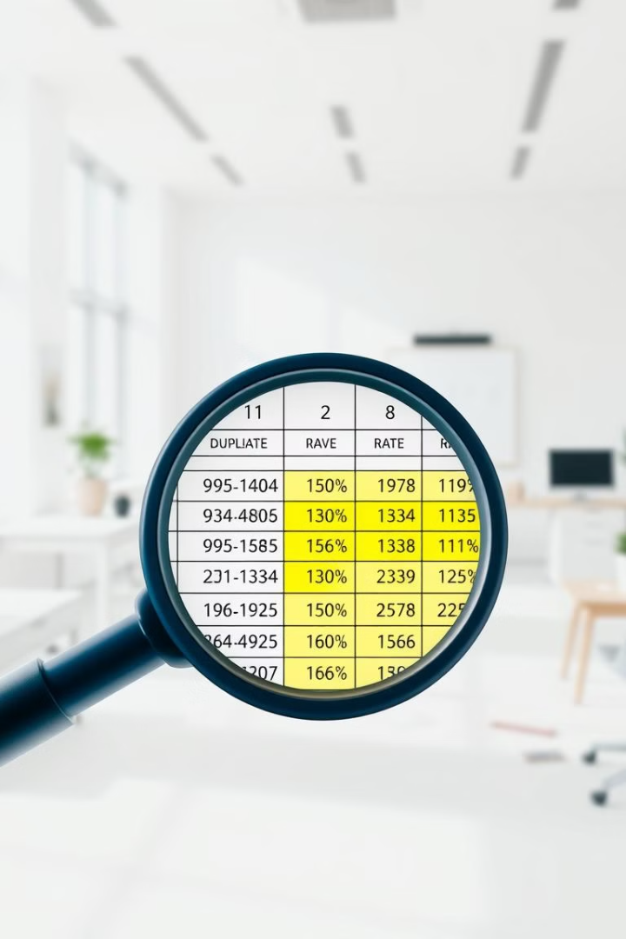
Handling Duplicates
Identify Duplicates
1
Use DataFrame.duplicated() to spot repeating rows. It flags duplicate entries for inspection.
Remove Duplicates
2
Apply DataFrame.drop_duplicates() to eliminate redundant data. Choose which occurrences to keep.
Verify Results
3
Double-check the cleaned dataset. Ensure important information wasn't accidentally removed.
Notes:
3

Slide 4

Managing Missing Values
Detection
Conditional Filling
Use isnull() and sum() to identify missing data. Quantify gaps in your dataset.
Fill missing values based on other column data. Maintain data integrity and relationships.
Interpolation
Forward/Backward Filling
Estimate missing values using linear or polynomial methods. Ideal for time-series data.
Use neighboring values to fill gaps. Suitable for categorical or slowly changing data.
Notes:
4

Slide 5
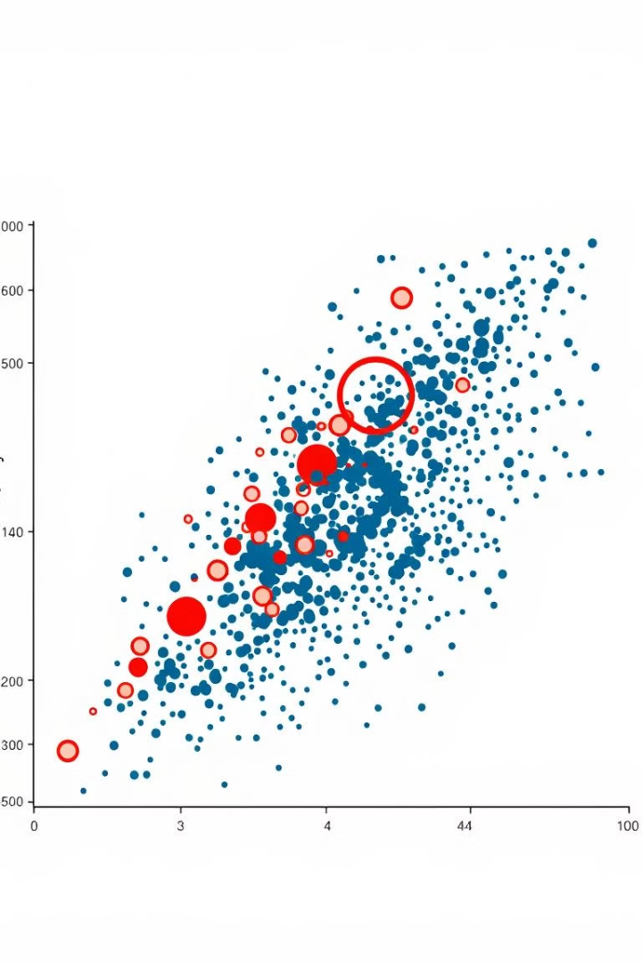



Outlier Detection and Handling
IQR Method
Define bounds using interquartile range. Identify values beyond 1.5 times the IQR.
Z-score Method
Standardize data to spot outliers. Flag values beyond three standard deviations.
Handle Outliers
Remove or cap extreme values. Choose based on domain knowledge and data context.
Notes:
5

Slide 6

Optimizing Data Types
Data Type
Optimization Technique
Memory Impact
Integer
Convert to smaller types
Up to 75% reduction
Float
Change precision if possible
Up to 50% reduction
Object
Transform to category dtype
Up to 90% reduction
Notes:
6

Slide 7




Practical Applications
Financial Analysis
Clean data improves stock predictions. It leads to more accurate market trend analysis.
Healthcare
Refined patient data enhances diagnoses. It supports more effective treatment plans.
Manufacturing
Optimized production data boosts efficiency. It helps identify and reduce waste in processes.
Notes:
7

Slide 8

Summary & Key Takeaways
1
Data Quality is Crucial
2
Efficiency Matters
Optimized data types save memory and boost performance. They're crucial for large datasets.
Clean data forms the foundation of reliable analysis. It's essential for accurate insights.
3
Continuous Process
Data cleaning is ongoing. Regular maintenance ensures data remains high-quality and useful.
Notes:
8

